Slide 1
Model Drift

Slide 2
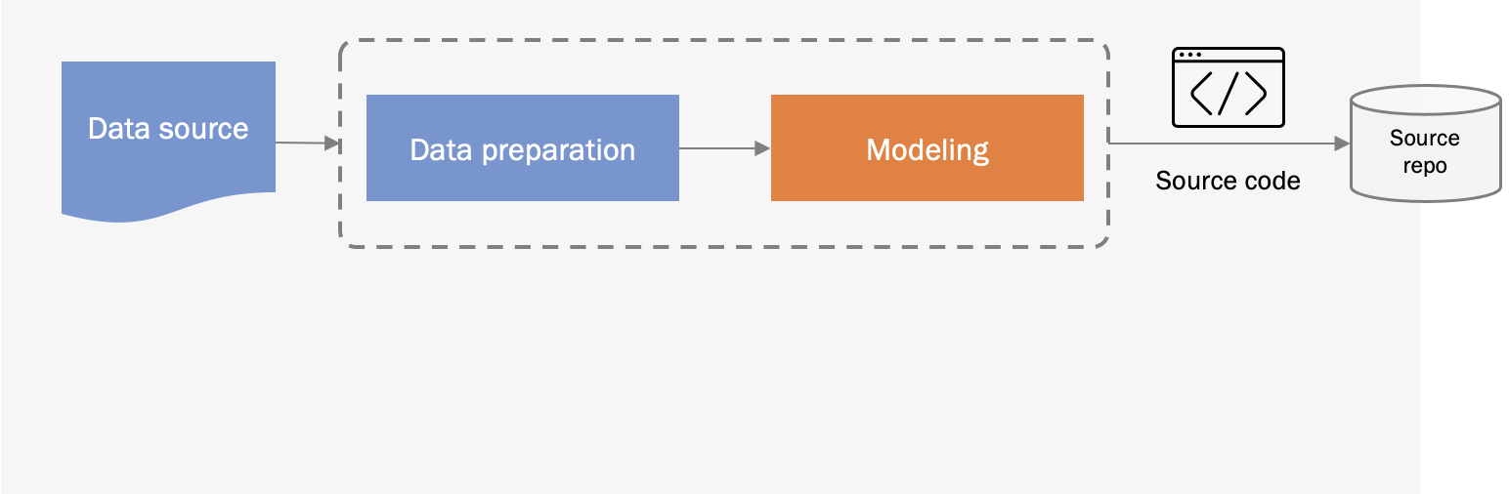
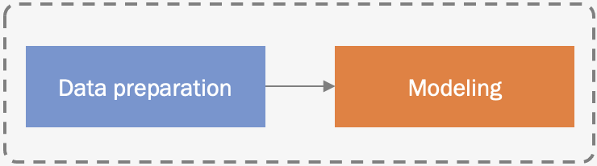

Model experimentation and development
CI/CD
Pipeline building and testing
Packages
CD Pipeline Deployment
Feature store
Model update cycle
Model serving
Continuous Deployment (CD)
Model repo
Training
Validation
Data validation
Data preparation
Model serving
Scaling
Logging
Monitoring
Trigger
Model monitoring
Model API
Live data

Slide 3
What may go wrong?

Slide 4
1
The distribution of data (inputs and labels)
2
Change in schema
What may go wrong?
3
Relationship between features and labels
4
A data source (eg maintained by others)
5
An upstream model

Slide 5
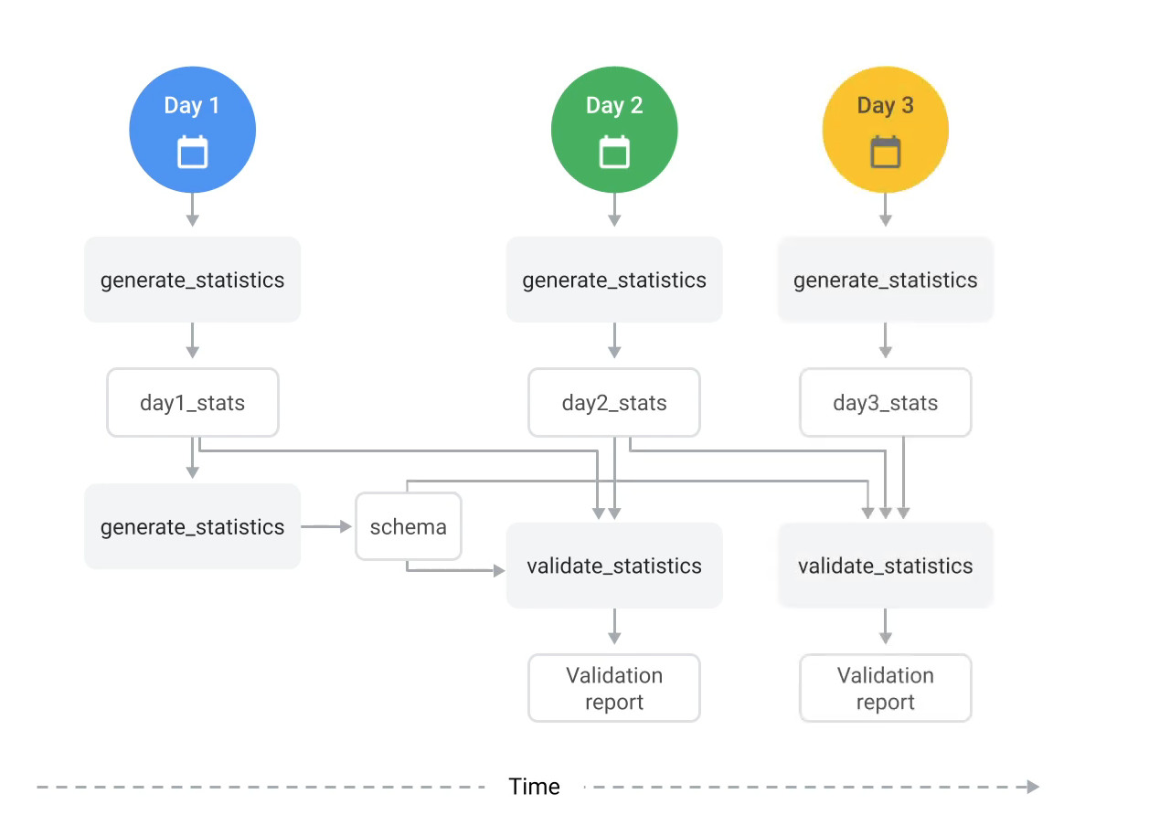
Validate continuously arriving data

Slide 6
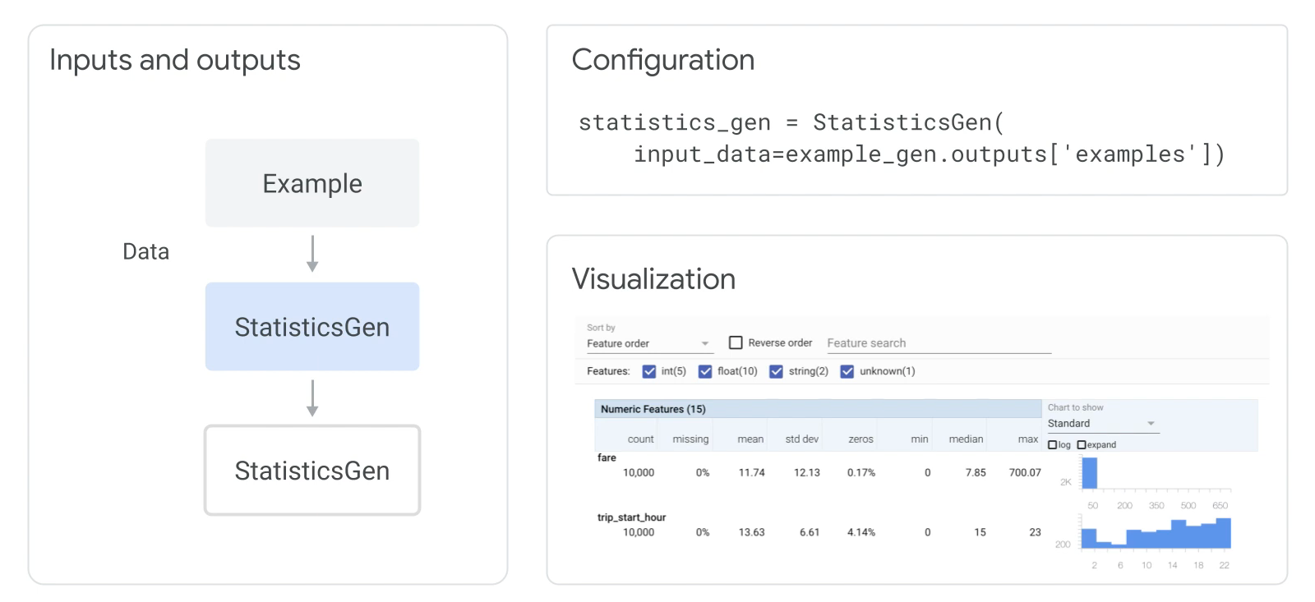
StatisticsGen Component

Slide 7
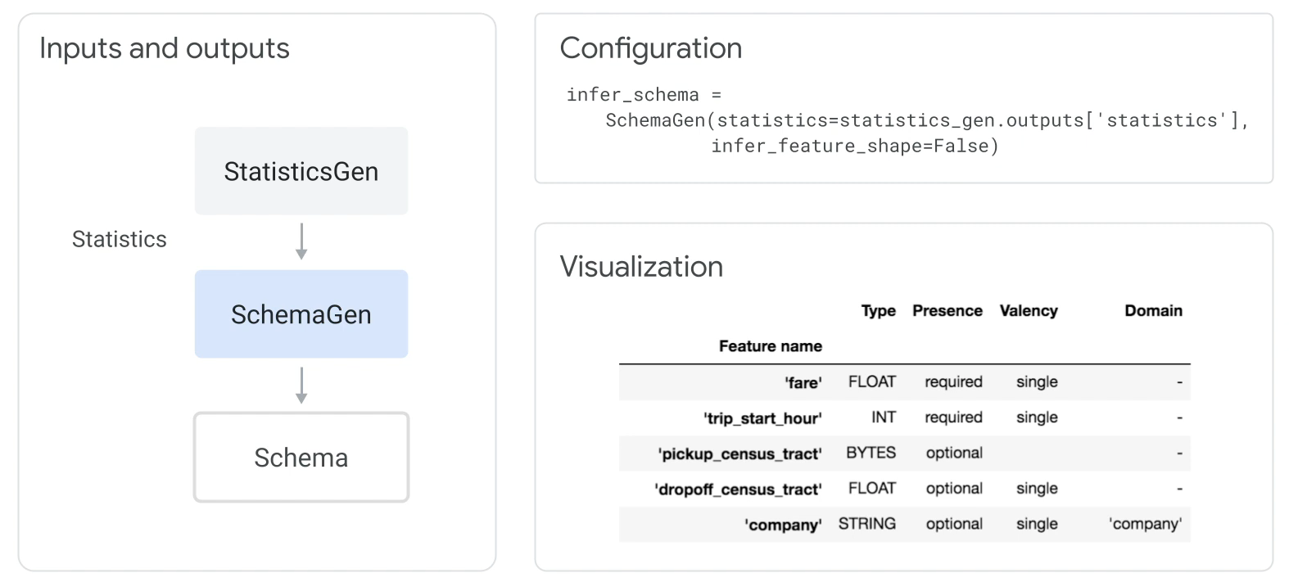
SchemaGen Component

Slide 8
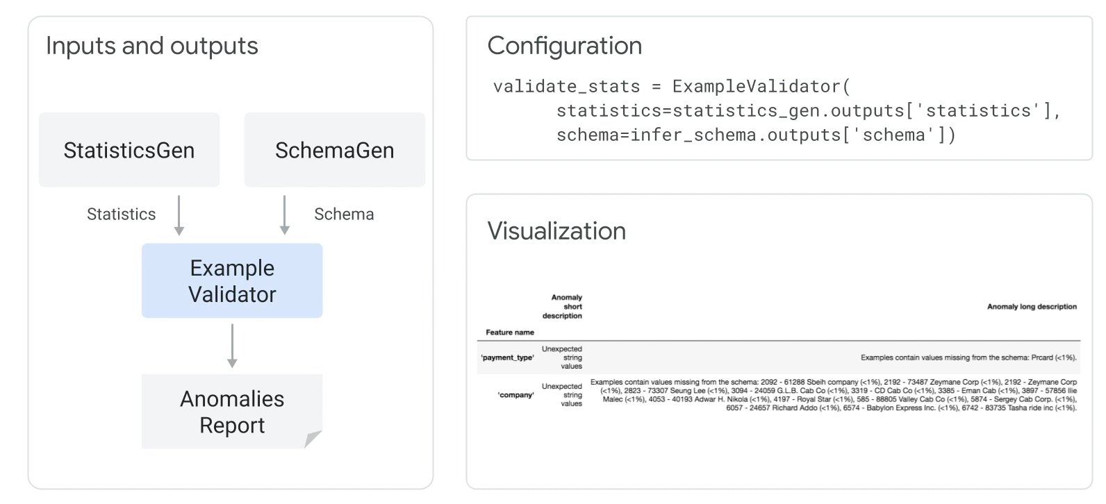
ExampleValidator Component

Slide 9
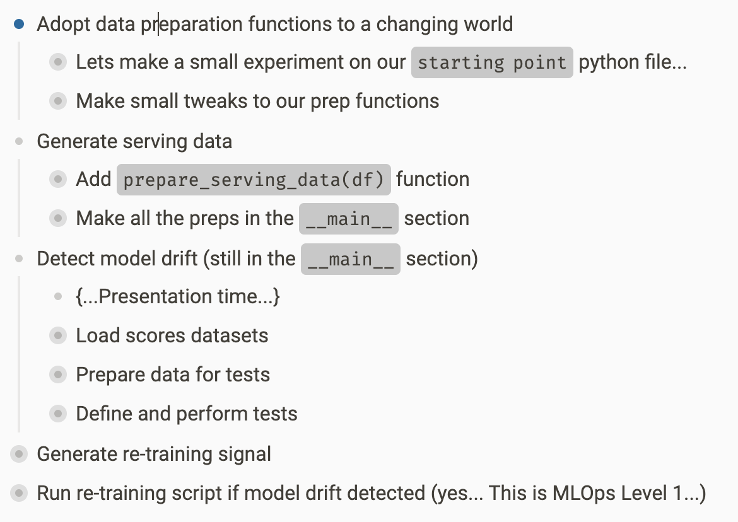
Our Workflow

Slide 10
Model Drift Tests

Slide 11
„Hard” test
Set a minimum acceptable level of model quality (e.g., min acceptable ROC_AUC or Accuracy level)
We trigger the signal when the model quality measure exceeds this threshold
Accuracy
Acc_{min}

Slide 12
Benchmarking test
We generate the signal when the model quality measure is worse than all previous values
The problem: sometimes this test is too sensitive.
The overtraining signal is triggered too often and unnecessarily
RMSE

Slide 13
Parametric signal
Higher is worse.
eg. RMSE, MSE, …
We generate the re-training signal in a situation where the the current value of the quality measure
is worse (smaller or larger) by two standard deviations from the average of the previous values
Procedure:
Calculate the average of the previous values of the measure
Calculate the standard deviation of the previous values of the measure
Check if the current measure value is worse (smaller or larger) than the mean +/- 2* standard deviation
Problem: sometimes our quality measure readings
do not follow a bell curve (eg because of outliers).
drift
mean
mean + 2𝜎
Lower is worse
eg. Accuracy, Precision, ROC AUC…
drift
mean - 2𝜎
mean

Slide 14
Non-parametric test (outlier detection)
We generate the re-training signal in case the current value of the quality measure is interpreted as an outlier and is worse than previous values
Procedure:
For a set of previous measures, calculate
Q1 (first quarile)
Q3 (third quartile)
Interquartile distance: IQR = Q3 - Q1
2. Determine the limits of "normal" values
Lower limit: Q1 - 1.5*IQR
Upper limit: Q3 + 1.5*IQR
3. For the new model quality measure, check that it is within the acceptable limits:
Q1 - 1.5*IQR < measure < Q3 + 1.5*IQR
4. Generate a post-training signal when:
the new value of the measure is outside these limits
and is worse than the others (smaller or larger, depending on the type of measure).
1 quartile = the value of the measure from which 25% of all measures in the set are smaller
For measures like Accuracy, Precision, Recall or ROC_AUC
For measures like MSE or RMSE
1Q
3Q
1,5 * IQR
IQR
1,5 * IQR

